Slide 1
Just Me

Slide 2
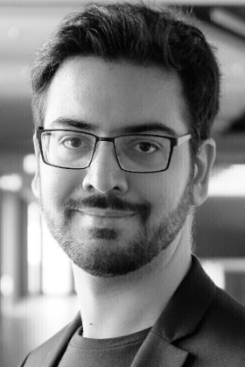
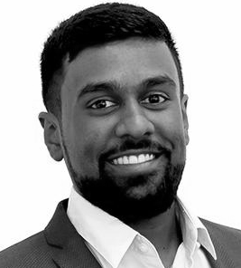
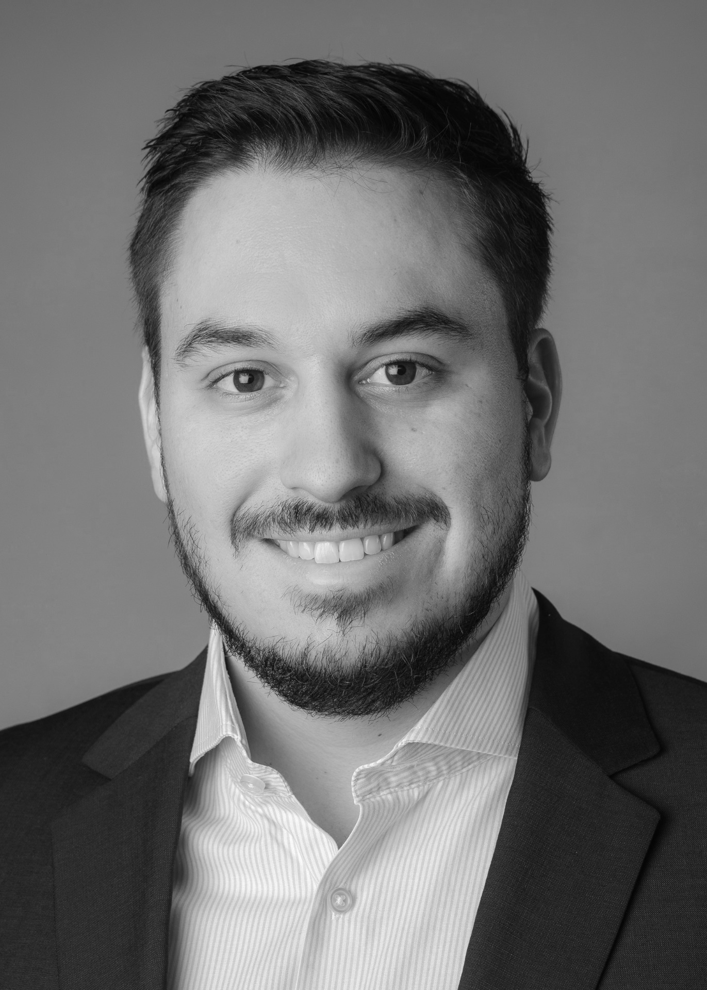
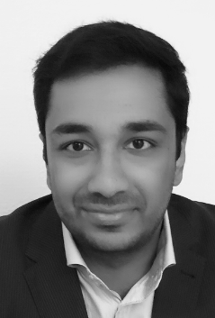
Our Team
Daniela S.
CEO & Process Owner
Egemen K.
Head of Engineering
Purushoththaman S.
Head of Marketing & Sales
Jonas F.
Senior Business Analyst
Alex P.
Senior Business Analyst

Slide 3
Today’s Society
Mega Trends
Gender shift
Neo ecology
Conciousness
Individualization
Connectivity / Globalization
Source: https://www.zukunftsinstitut.de/index.php?id=1532

Slide 4
Our Idea
Fast and easy access to eco friendly and fair produced clothes.
Individualized
Ready made
Customers should be able to find clothes in all price classes → Mass market (eco-friendly line)

Slide 5
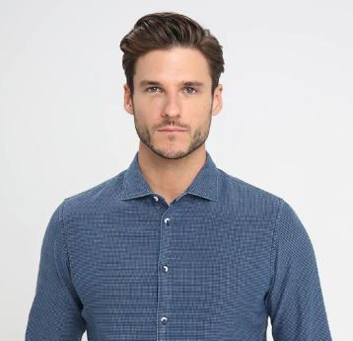
Persona
Max
Age: 30
Financial background: Middle class
Job: Business Analyst
Character: Eco-friendly, human rights activist, busy schedule
Unique body structure
Max’s Shopping Behaviour
Online shopper
Enjoys individualized clothing
Eco friendly and tailor made

Slide 6
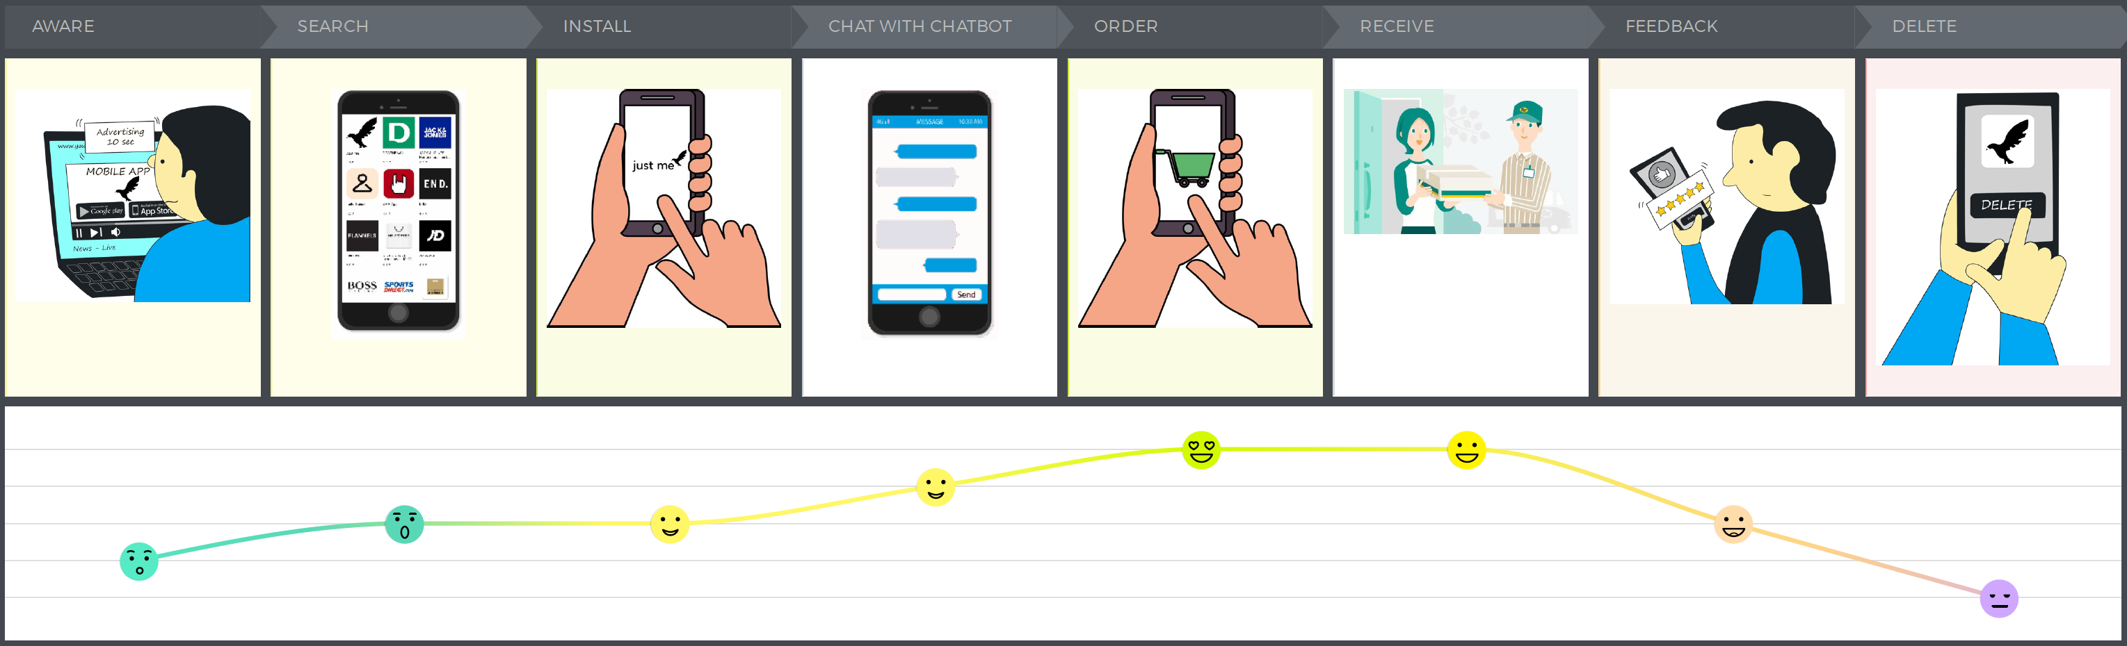
Customer Journey

Slide 7
Max is going on a shopping tour

Slide 8
Live Demo

Slide 9
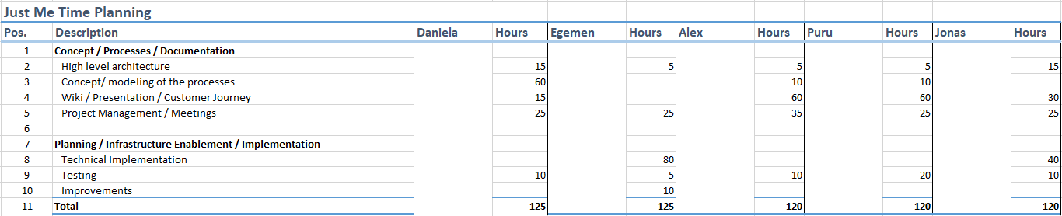
Project Approach
Requirements
Design
Implementation
Verification
Maintenance

Slide 10
Major Challenges
Coordination between project members
Time Planning
Technical Implementation
Know How sharing

Slide 11
Q&A

Slide 12
Back Up Slides

Slide 13
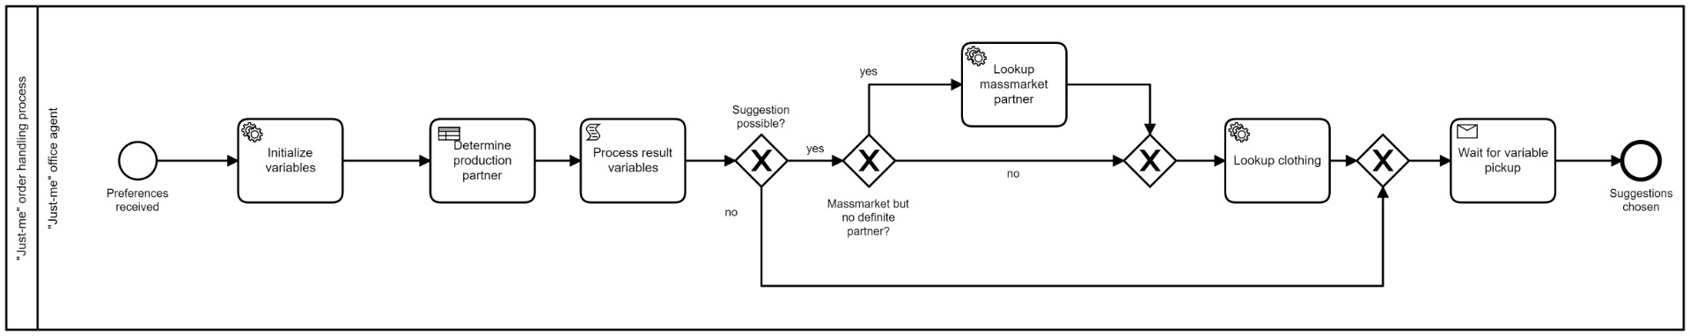

Slide 14
